Slide 1
LECTURE 7: Long Distance Communication
Means Sending data signals over long distance
encoding techniques employed when using the RS 232 cannot work all the times.
need to use the telephone network
Telephone network require the use of different encoding strategies
Electric current becomes weaker over long distances
Signal loss prevents accurate decoding

Slide 2
RS-232 and signal loss
_ signal loss worse when RS 232 cables are used over long distances
RS 232 virtually not used for transmitting signals over long distances
Long distance communication systems use continuous oscillating electromagnetic wave called a carrier
Motivation for using carrier signals:
- Select a frequency that will propagate well and independent of the rate at which data is being sent out

Slide 3
Electric current becomes weaker when it propagates on the wire over a long distance.
This results in signal loss and prevents accurate decoding of data signals at the receiver.
Most long distance communication systems use a continuous oscillating electromagnetic wave known as a carrier.

Slide 4
Motivation for carrier signal
The motivation for the use of a carrier signal arises from the desire to select a frequency that will propagate well independent of the rate at which data is being sent out (Comer, 2009).
The term modulation is used to describe the process of accepting a signal and converting it to an appropriate format for so as to be transmitted over the appropriate medium.

Slide 5
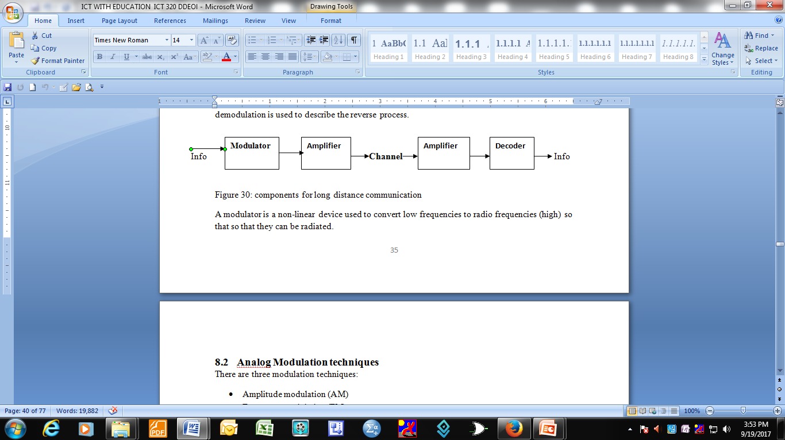
Components of long distance communication
The term demodulation is used to describe the reverse process.

Slide 6
modulator
A modulator is a non-linear device used to convert low frequencies to radio frequencies (high) so that they can be radiated.

Slide 7
Analog Modulation techniques
Three modulation techniques:
Amplitude modulation (AM)
Frequency modulation (FM)
Phase Modulation (PM)
AM and FM techniques: most common been used for a long time for radio and television broadcasts.
AM transmission
- the carrier signal is modulated so that its amplitude varies with the changing amplitudes of the modulating signal.
- The frequency and phase of the carrier signal remain unchanged. There are three signals involved:
Modulating signal
Carrier frequency
AM signal

Slide 8
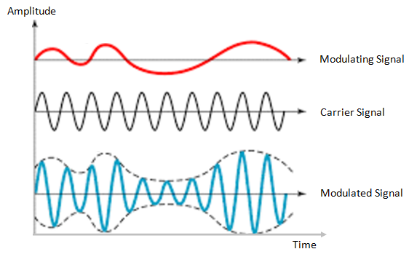
Amplitude Modulation

Slide 9
AM bandwidth
The modulated signal is the sum of the modulating signal and the carrier signal.
AM bandwidth
The bandwidth of the AM:
Is signal is twice the bandwidth of the modulating signal and it covers a range centred on the carrier frequency.
Total bandwidth required for AM can be calculated from the bandwidth of the audio.

Slide 10
Bw_{t} = 2 x BW_{m}
where BW_{m} is the bandwidth of the modulating signal (audio),
Bw_{t} is the total bandwidth (radio).

Slide 11
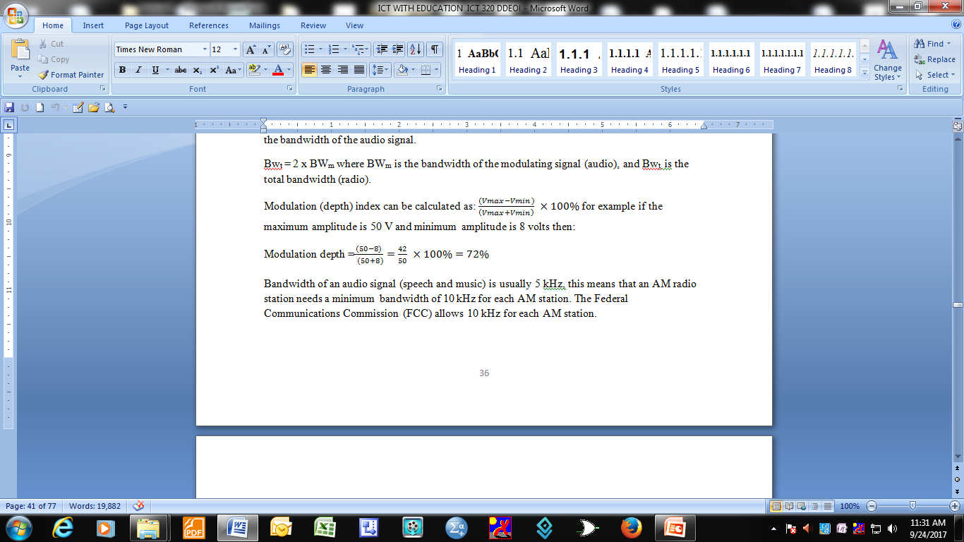
Calculating modulation depth

Slide 12
Bandwidth of an audio signal (speech and music) is usually 5 kHz,
- this means that an AM radio station needs a minimum bandwidth of 10 kHz for each AM station.
The Federal Communications Commission (FCC) allows 10 kHz for each AM station.

Slide 13
AM station
AM stations are allowed carrier frequencies between 530 Hz and 1700 kHz
Each station’s carrier frequency (fc) must be separated from those on either side by at least 10 kHz to interference (see figure below)

Slide 14
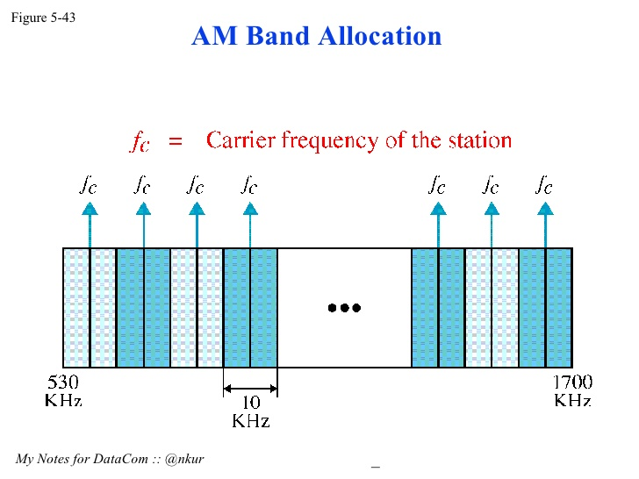
AM band allocation

Slide 15
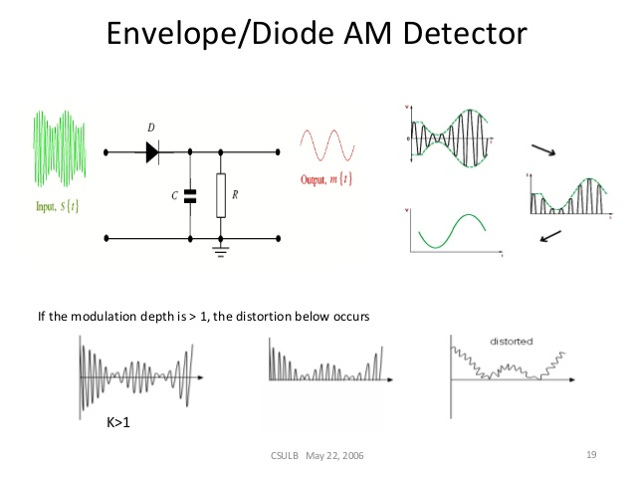
Advantages of AM
Simple to implement
Can be modulated using a simple circuits that uses very few components

Slide 16
The capacitor removes the radio frequency element (see the input and output signals).
Disadvantages
AM is not efficient in terms of power usage as well as in terms of bandwidth. It requires a bandwidth equal to twice that of the highest radio frequency
AM is prone to high levels of noise because most noise is amplitude best and AM detectors are very sensitive to noise.

Slide 17
Frequency Modulation
The frequency of the carrier signal is modulated to follow the changing voltage level (amplitude) of the modulating signal.
The peak amplitude and the phase of the carrier signal remain constant at a particular period
but as the amplitude of the information signal changes, the frequency of the carrier changes correspondingly (diagram).

Slide 18
FM bandwidth
FM bandwidth is equal to 10 times the bandwidth of the modulating signal.
It covers a range centred on the carrier frequency and the total bandwidth required can be determined from the bandwidth of the audio signal BW_{t} = 10 x BW_{m}
The bandwidth of the audio signal (speech and music) broadcast in stereo is almost 15 kHz, so the FM radio station needs a minimum of 150 kHz . The FCC allows 200 kHz for each FM station to provide room for guard bands. The FM radio stations are allowed carrier frequencies between 88 and 108 MHz but the stations must be separated from each other by at least 200 kHz to avoid overlapping (see figure 36 below).

Slide 19
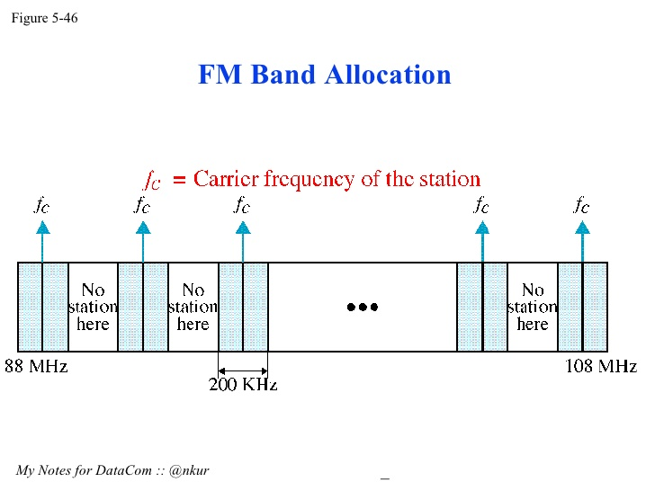
FM Bandwidth

Slide 20
FM advantages
Advantages of FM
Resilient to noise- noise is amplitude based. FM uses limiters where only frequency variation appear
Resilient to signal strength variations, that is does not suffer audio amplitude variations as the signal varies. This makes FM ideal for in mobile applications where signal variations constantly vary
Does not require linear amplifiers in the transmitter as only frequency changes are required
Enables greater efficiency than many other techniques

Slide 21
Disadvantages
Disadvantages of FM
Requires more complicated demodulator and therefore slightly more expensive than AM
It has a lower data spectral efficiency than other techniques such as phase modulation and quadrature amplitude modulation.

Slide 22
Phase Modulation
In phase modulation (PM), the phase of the carrier signal is modulated to follow the changing voltage level of the modulating signal (information signal). The peak amplitude and the frequency of the carrier signal remain constant.
Phase modulation is not used in analog transmissions because of the complexity of the circuit used and the difficulty of telling whether there has been a change shift by +180⁰ or - 180⁰

Slide 23
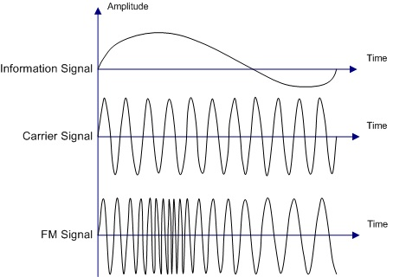
Frequency Modulation

